Slide 1

Company Introduction

Slide 2

Company History
1958 Establishment of construction materials wholesale company
1987 Establishment of first boutique hotel
1990 Beginning production of PVC windows and doors
1990 Establishment of second boutique hotel
1994 Beginning production of double glazing units
1996 Obtained licence of Trakya Cam double glazing units production
2008 Beginning production of tempered glass with brand name of Astro Glass
2013 Establishment of second tempered glass production facility

Slide 3
Vision & Mission
Vision
  As a solution partner for the leading brands in Turkey and abroad, being always the first company to preffered to work with.
Mission
  To be production and export base of Europe by producing high value-added goods and services.

Slide 4
Our Values
Differentiate on each job we do
Meet the quality expectations
Perform services on worldwide standards
Create a partnership with our customers
Promise on what we really can do
Grow with sustainability perspective

Slide 5
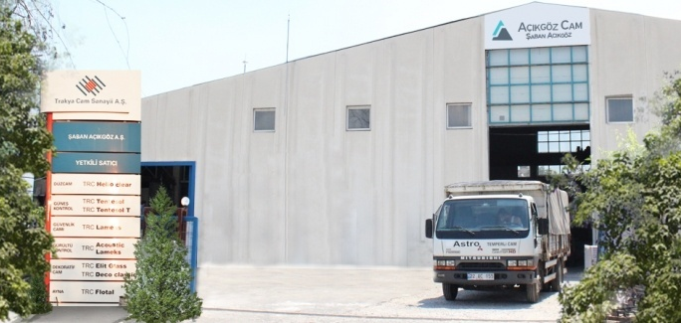
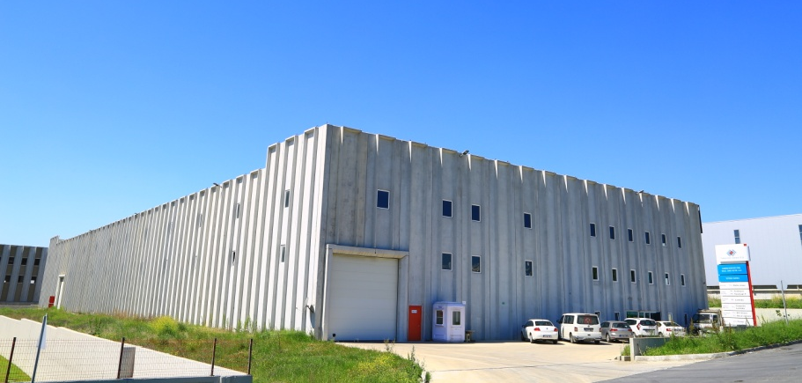
Production Facilities
Edirne
Çerkezköy
Establishment: Edirne in 2008, Çerkezköy in 2013
Number of Employees: 40
Covered Area: 6.000 m²
Tempering Capacity: 700.000 m²

Slide 6
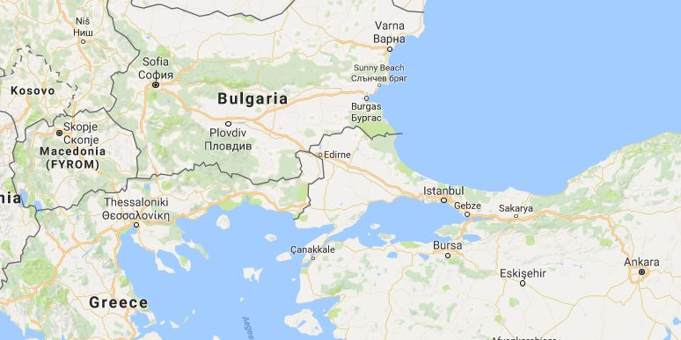

Location
I.Factory
Edirne
II.Factory
Çerkezköy
Sales Office
Istanbul

Slide 7
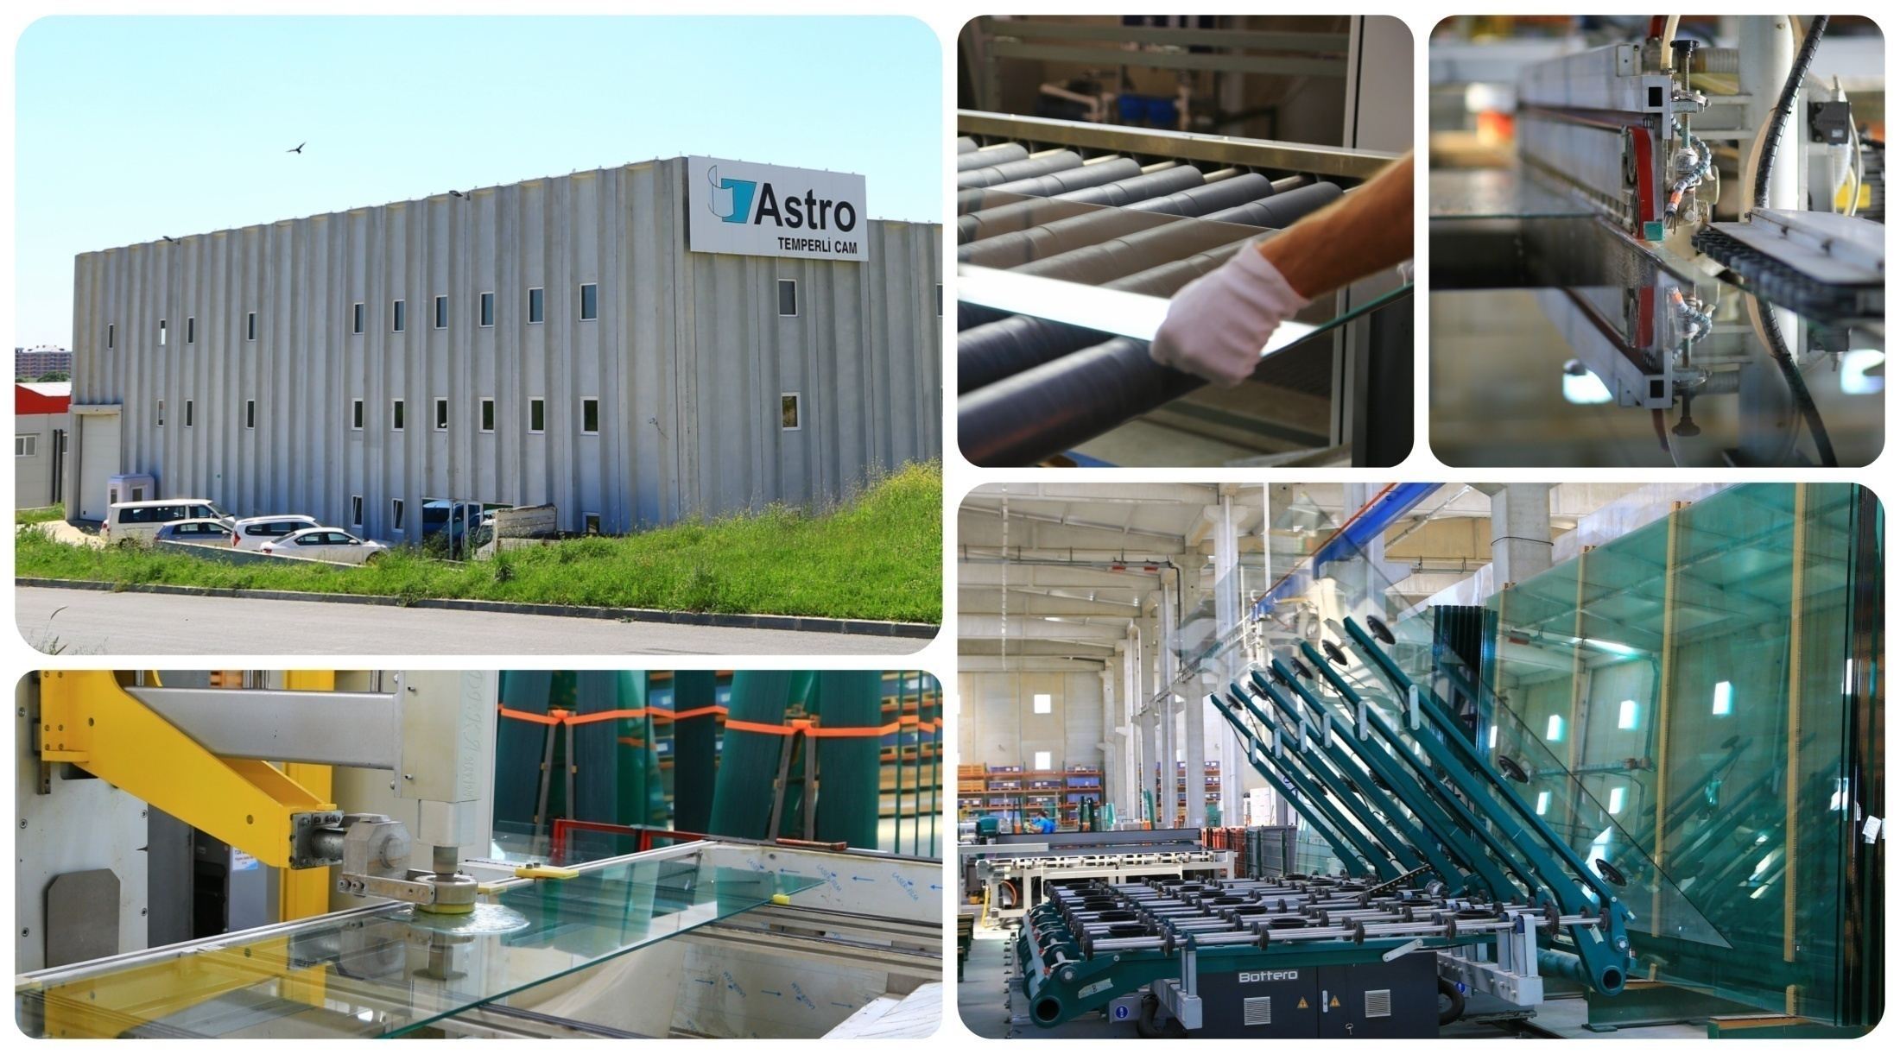
Production

Slide 8
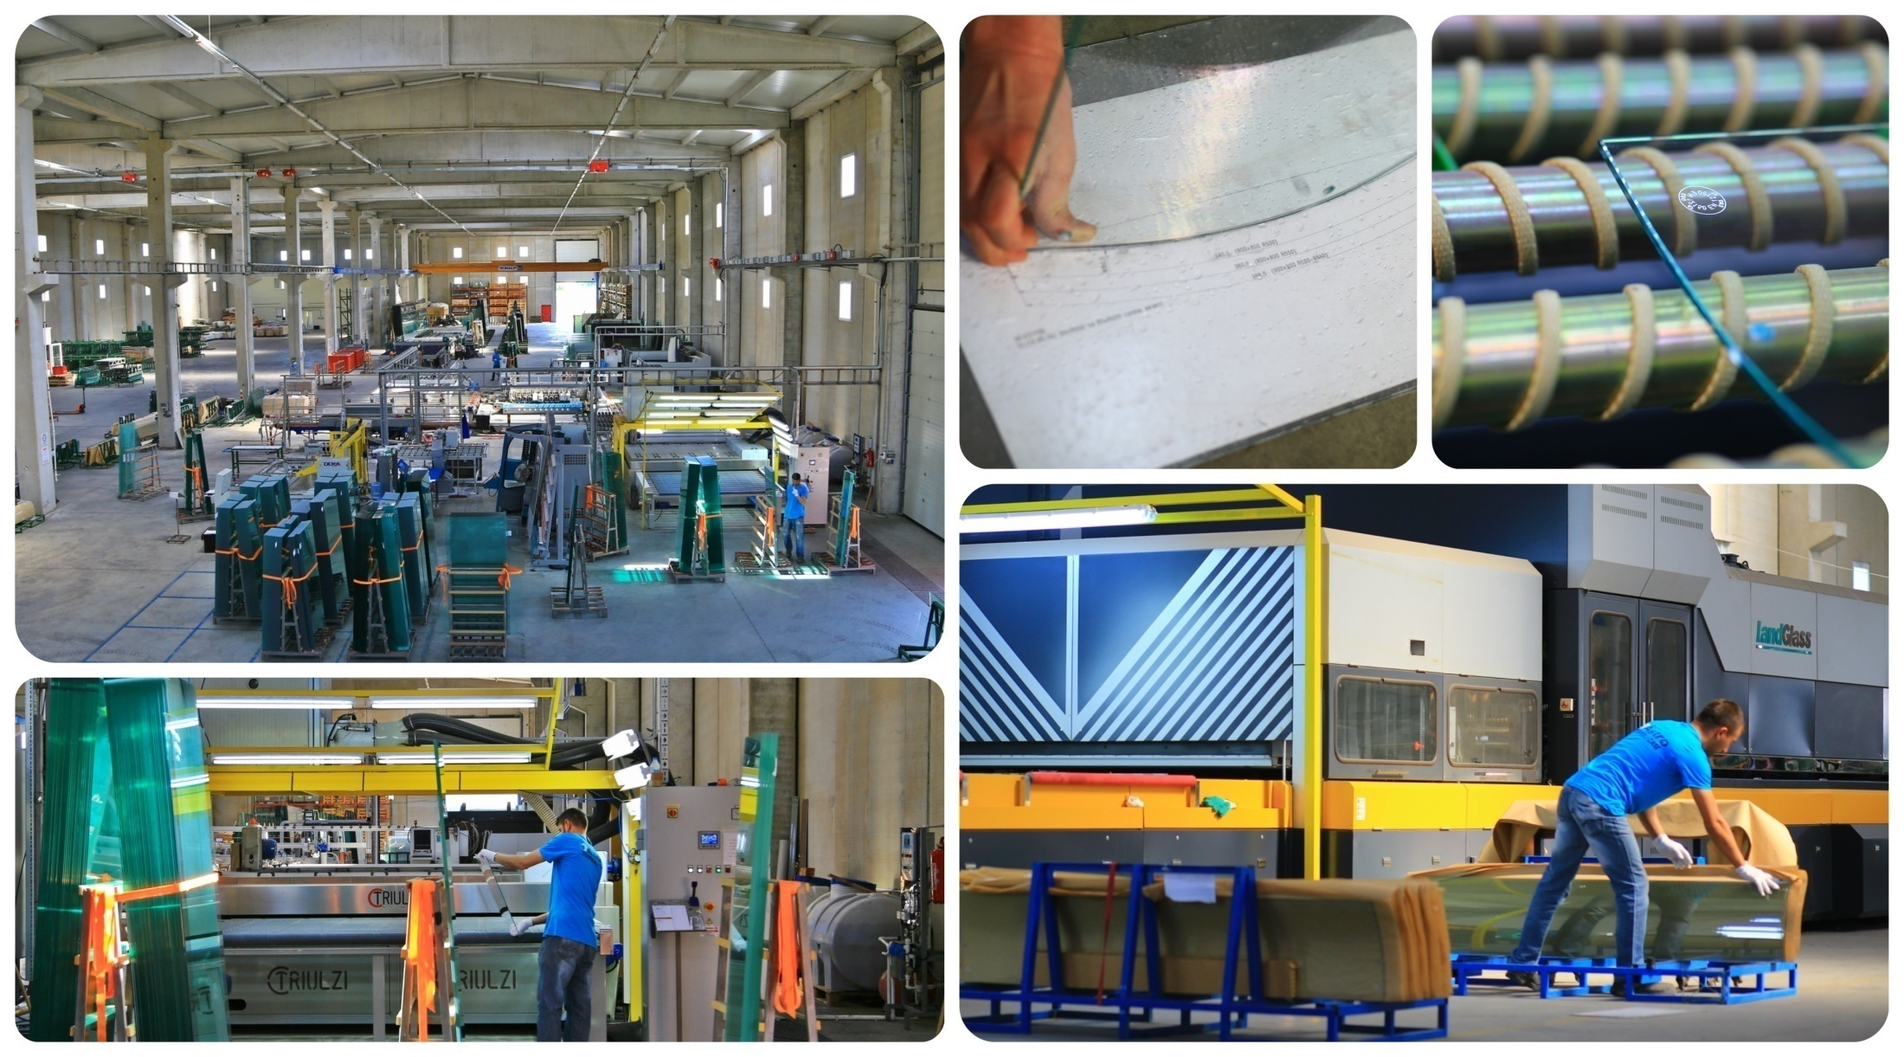
Production

Slide 9
Quality Policy
Getting always better about products and service quality
Manufacturing environmentally friendly products at the right time with the best quality
Following sector trends to keep our production technology is on advanced level
Organizing internal trainings, assessment meeting and developing suggestion systems
Avoiding environmental pollution by searching environmental friendly machines and processing technology

Slide 10
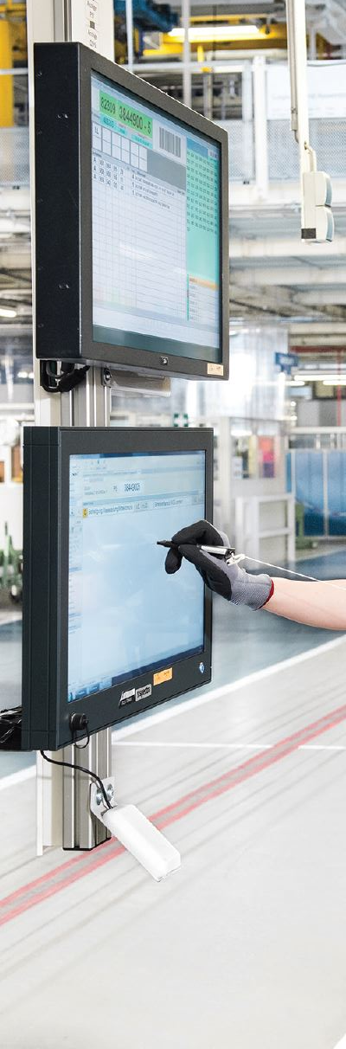
Production Planning and Monitoring System
Planning:
  Gathers all orders on a pool
  Sequences according to due date
Inspection:
  Checks production in real time
  Recognices possible delays
Monitoring:
  Gathers report in terms of time, shift, date and work station
  Reports any defects caused from raw glass or processing
Productivity:
  Analyzes production reports
  Gathers relevant data about shift and work station productivity
  Identifies incompetences of shifs and work stations

Slide 11
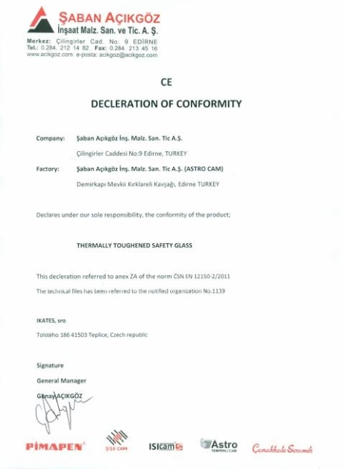
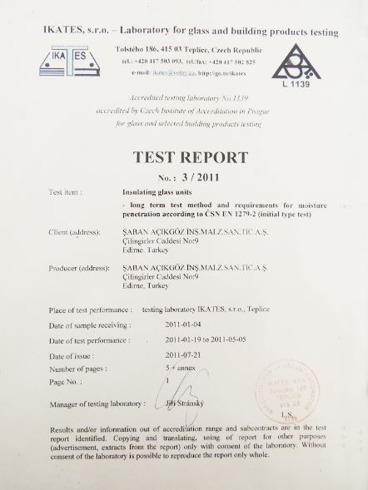
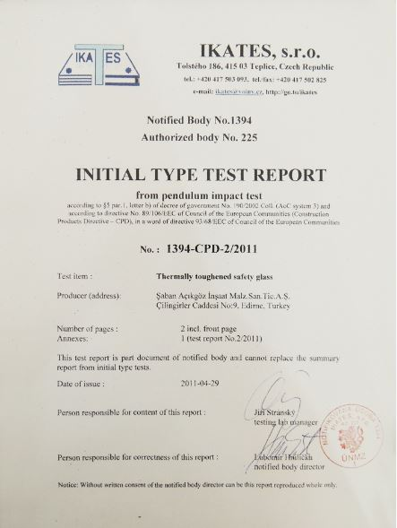
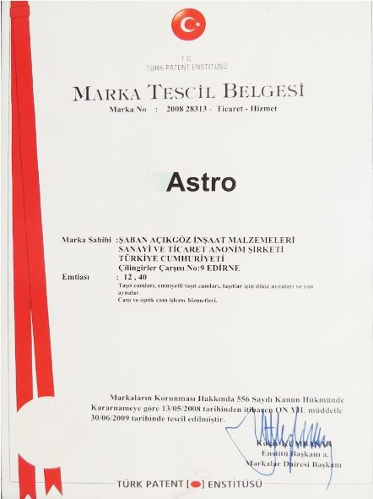
Certificates

